Slide 1
MIE1624 Project
Group 9
Da Da
Sheng Gao
Baoheng Kuang
Yunran Qiu
Ruoling Yang
Yaqi Zhang

Slide 2
Overview
Part 1 – Background
Part 2 – Course curriculum design
Part 3 – Data Science program curriculum design
Part 4 – Visualizations of course curriculum
Part 5 – Data Science education EdTech effort

Slide 3
Part 1
Background

Slide 4
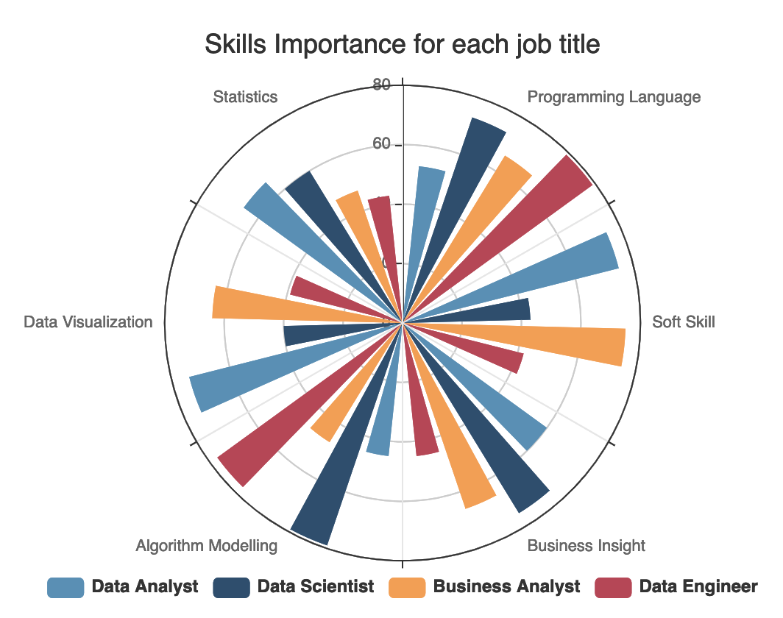
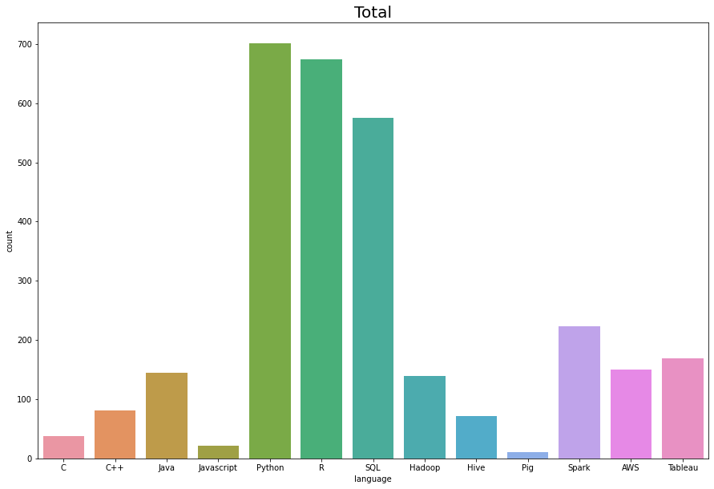
Most important skills for each role and Most Demanded Programming Language for Data Science
Programming Language using in Data Science

Slide 5
Part 2
Course curriculum design

Slide 6
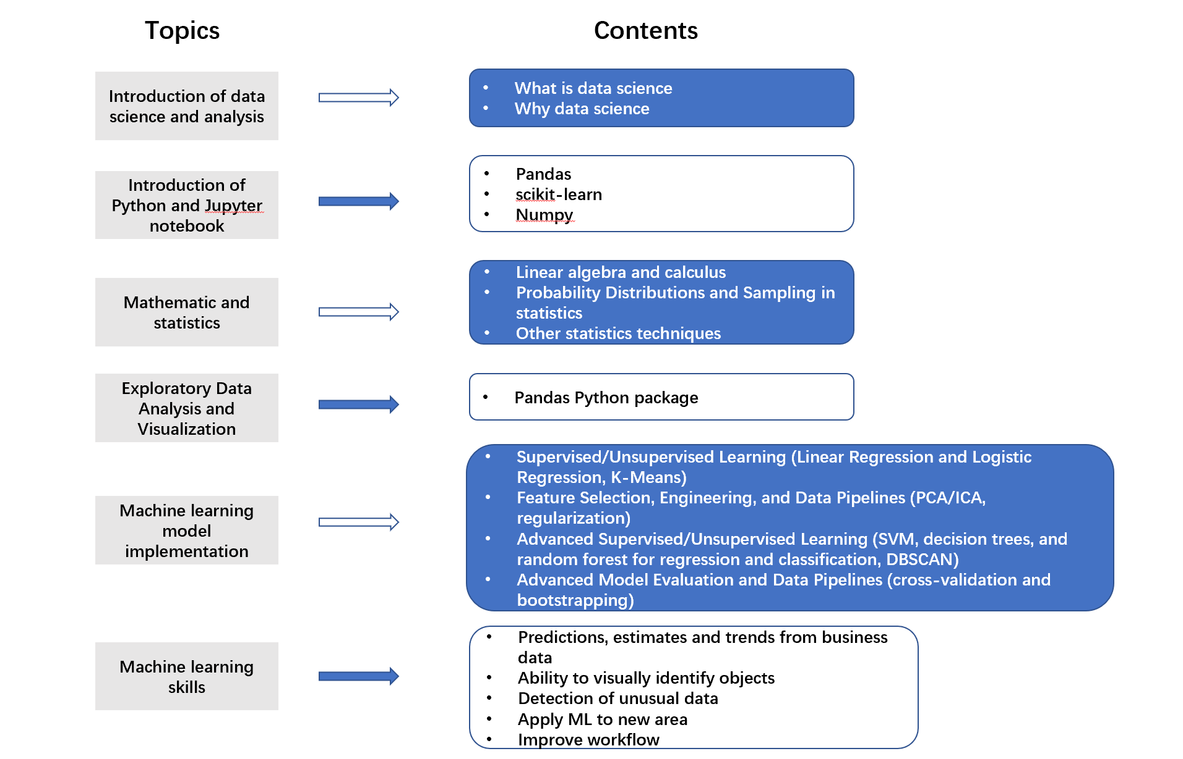
Course Curriculum

Slide 7
Part 3
Data Science program curriculum design

Slide 8
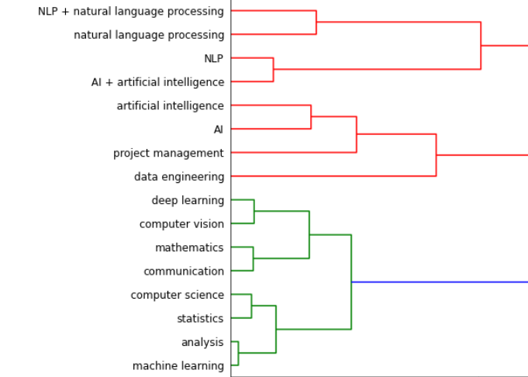
Program Curriculum
Introduction to SQL
Natural Language Processing
Artificial Intelligence:
Principles and Techniques
Project Management
Introduction to Data Engineering
Deep learning and
Computer Vision
MIE 1624 assignment 1
Communication and Business Organization
Fundamental Statistics in Computer Science
Introduction to Machine Learning and Data Analysis I & II

Slide 9
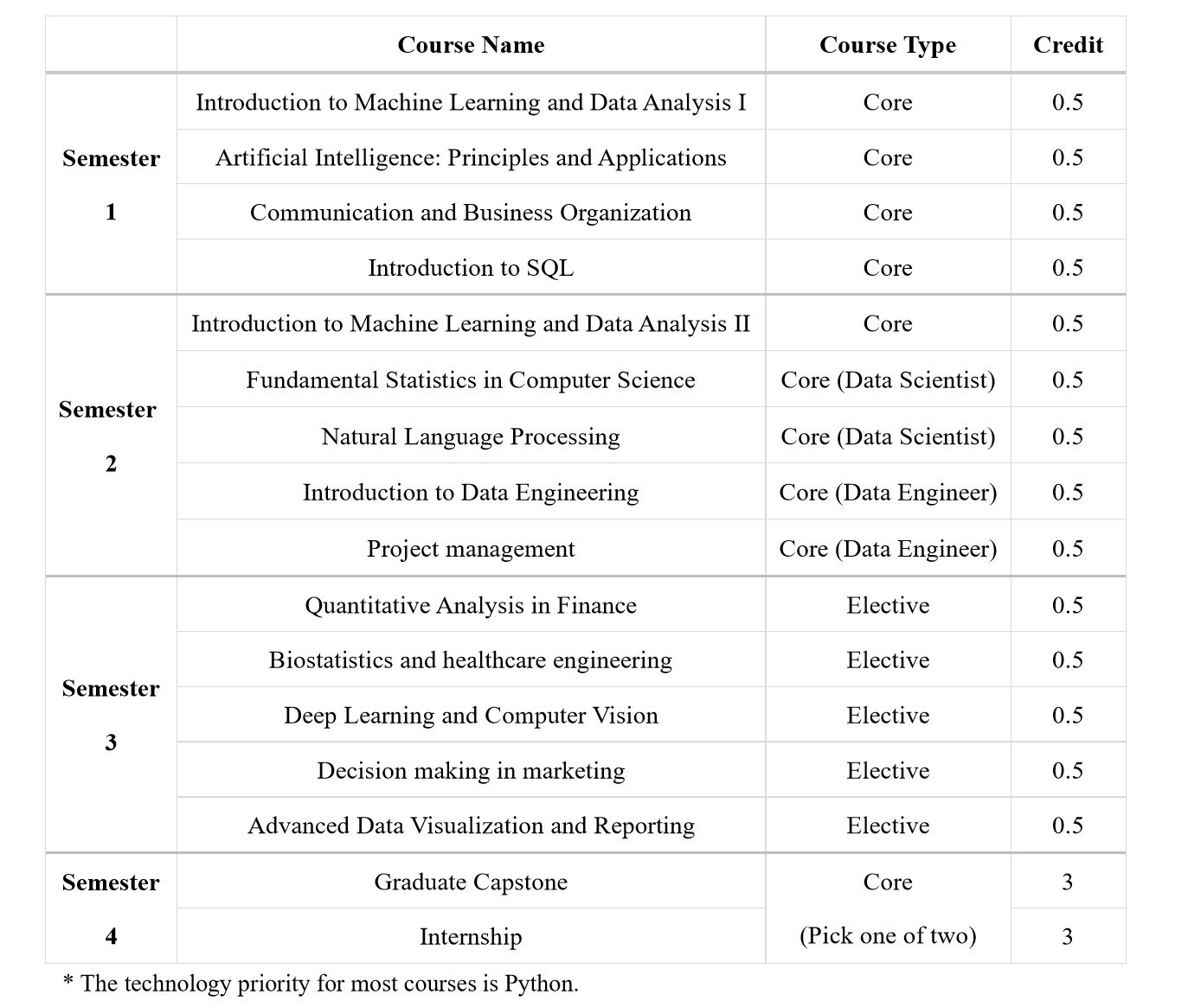

Slide 10
Part 4 Visualizations of course curriculum

Slide 11
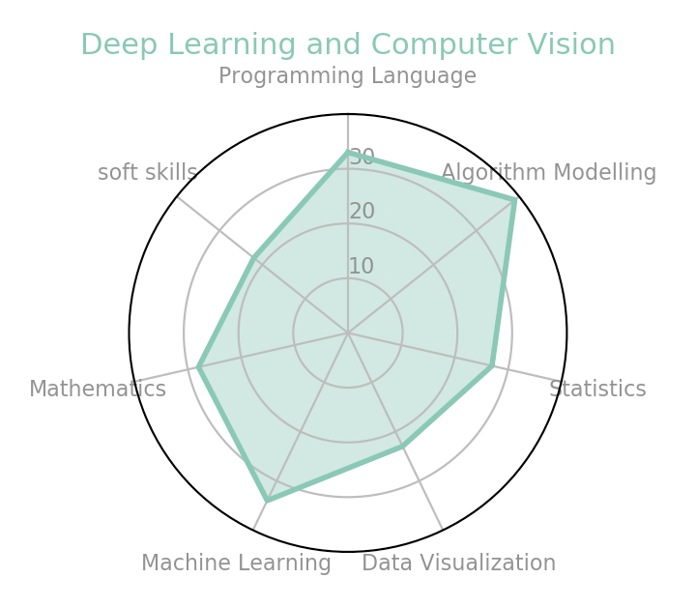
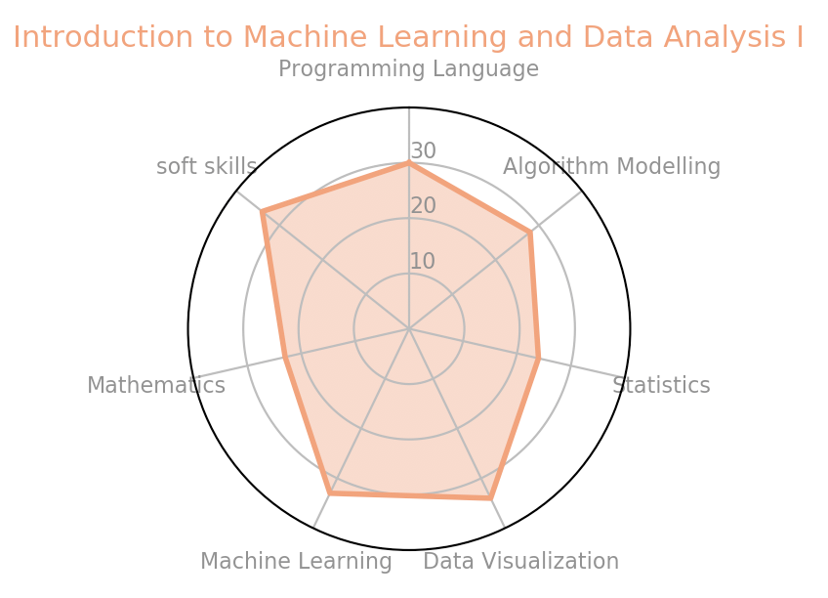
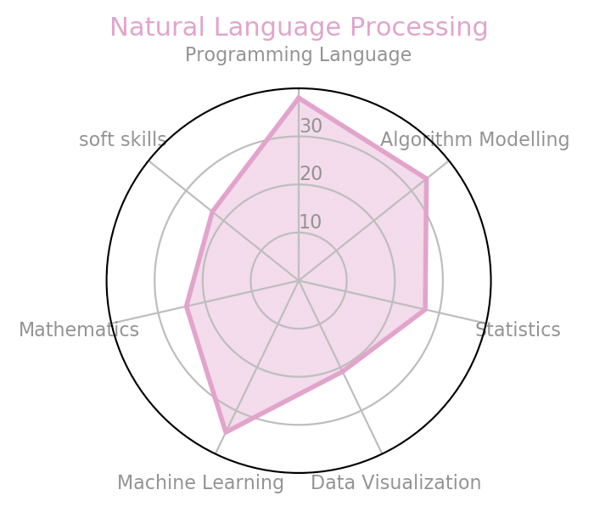
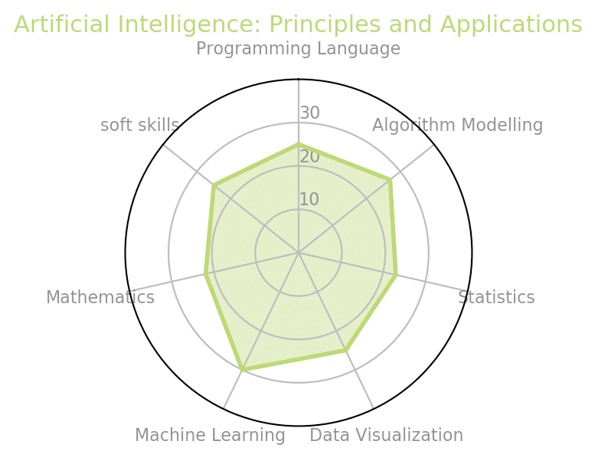
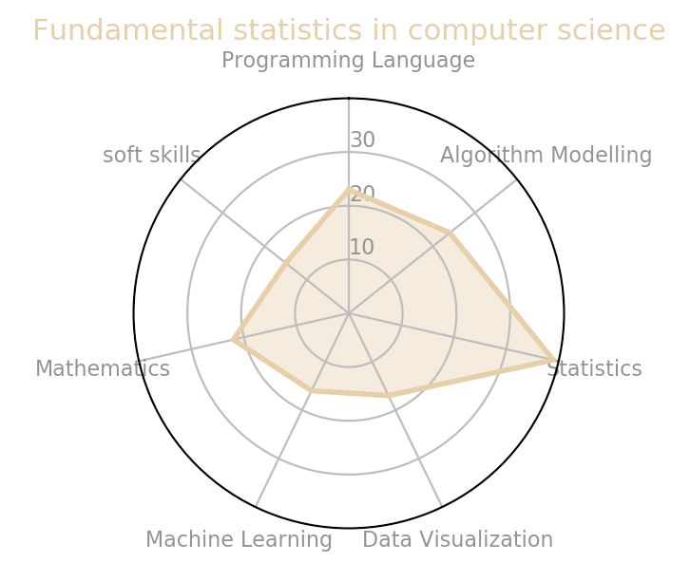
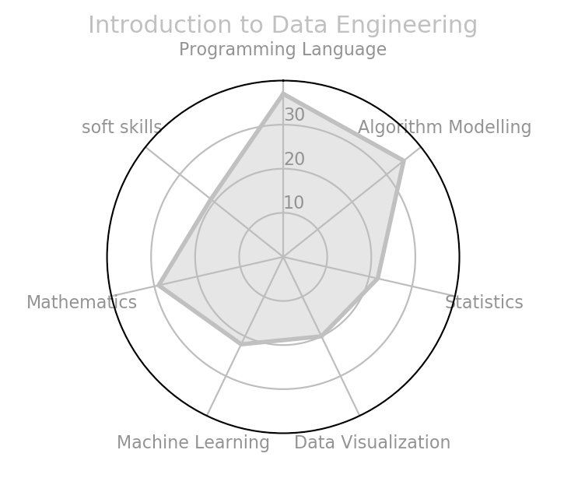
Course Visualization

Slide 12
Courses Sequence in Master of Data Science and Artificial Intelligence(Recommended)
Semester 1
Fundamental statistics in computer science
Introduction to Machine Learning and Data Analysis I
Communication and Business Organization
Gain basic skills and knowledge from mathematics, statistics, programming language(Python, SQL), Machine Learning and soft skills in business. These are the foundation to the advanced data science and AI.
Artificial Intelligence: Principles and Applications
Focus in pursuing Data Scientist
Introduction to Data Engineering
Focus in pursuing Data Engineer
Semester 2
Introduction to Machine Learning and Data Analysis II
More specific and advanced skills in deep learning, algorithms, data mining focusing on Data Science and Data Engineering, respectively.
Deep Learning and Computer Vision
Natural Language Processing
Semester 3
Semester 4
1 elective course in specific industry
Build business senses and insights in Data Science and AI, make a closed connection with the industry through overcome real issues by data science.
Capstone or Internship
Provide an internship or project which lead students to gain real work experience in Data Science specified in different area.
Master of Data Science and Artificial Intelligence

Slide 13
Part 5
Data Science education EdTech effort

Slide 14



Interested in Data Science?
Want to improve specific skills in Data Science?
Pursuing a data scientist role in future?
Our searching tool can connect your interests with related courses!

Slide 15
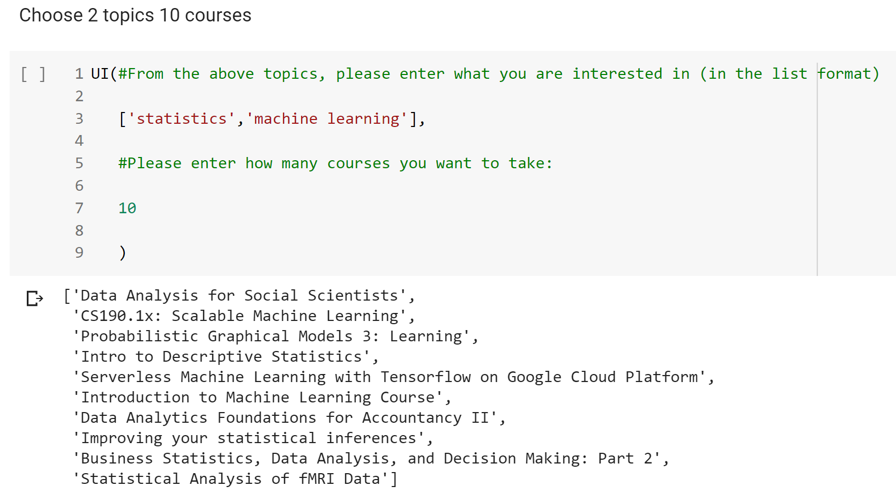
Case 1

Slide 16
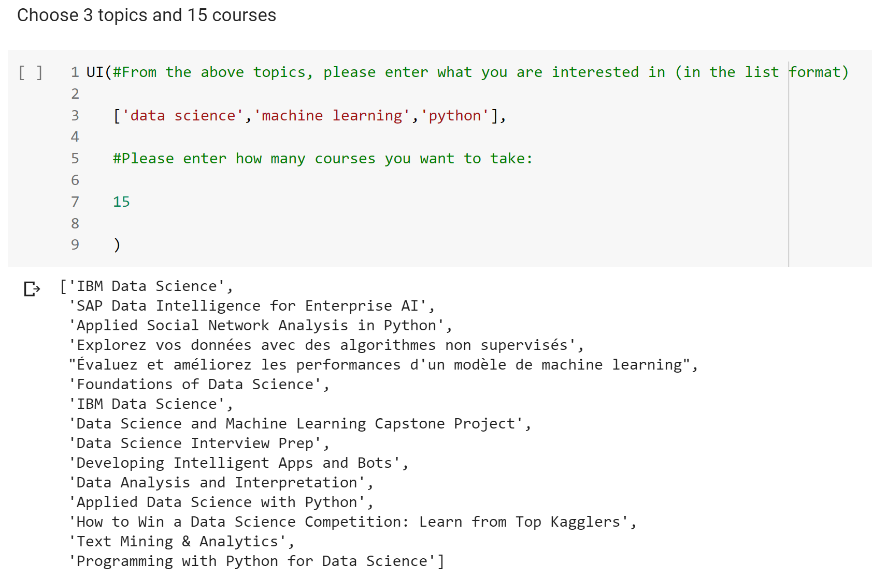
Case 2

Slide 17
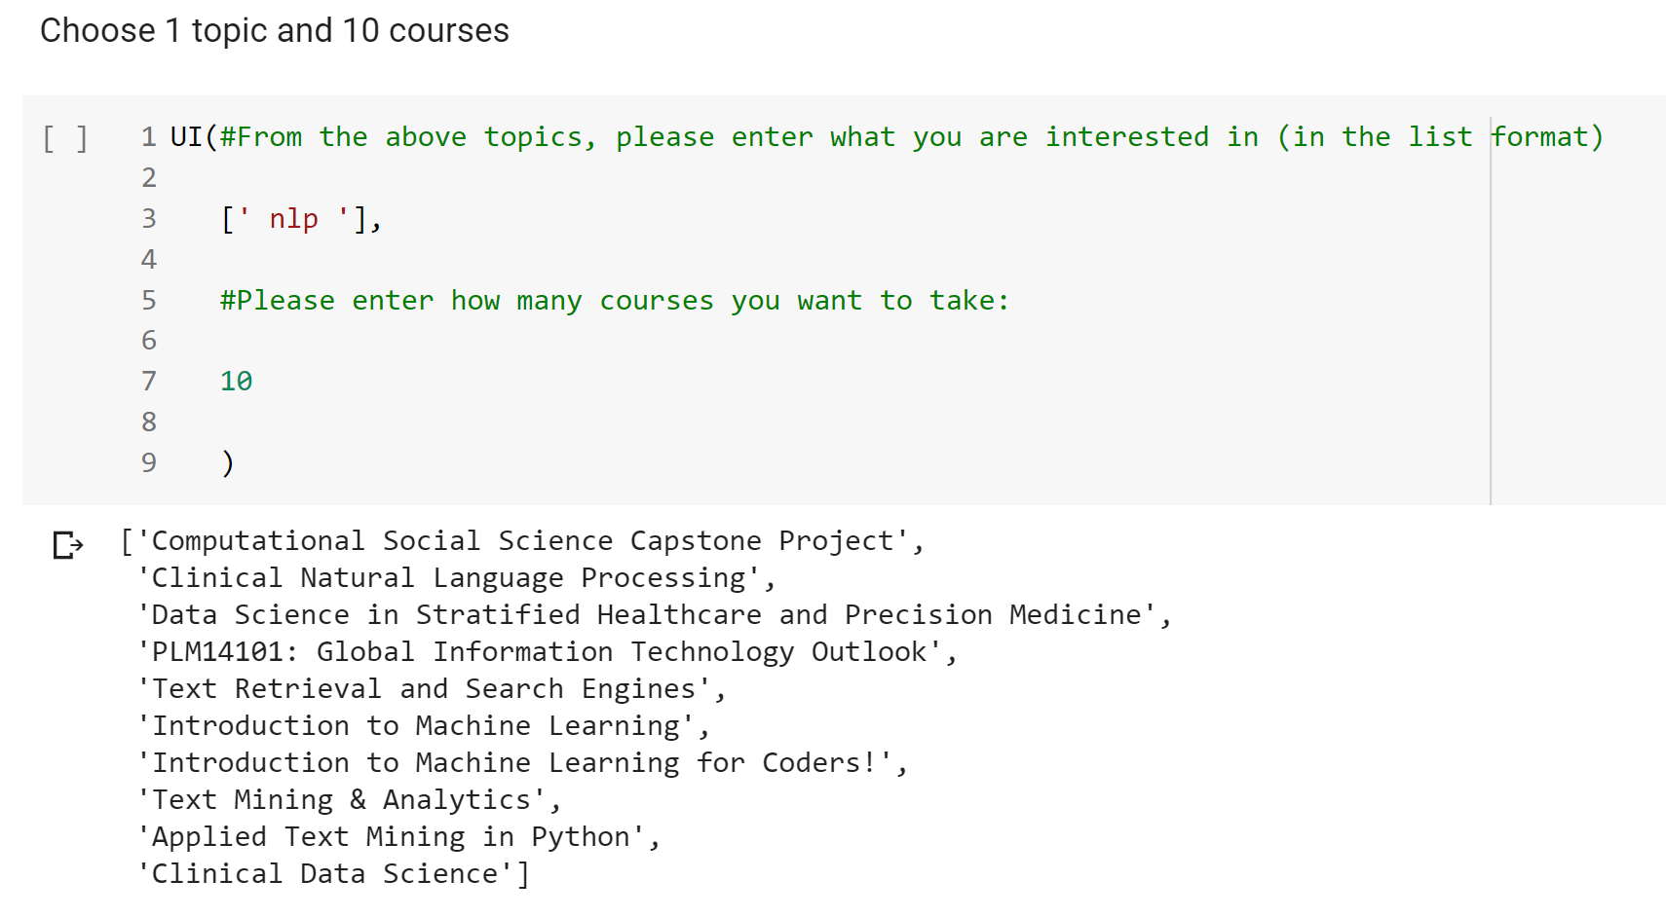
Case 3

Slide 18
Thank you

